Slide 1



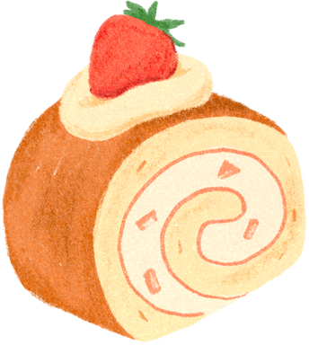








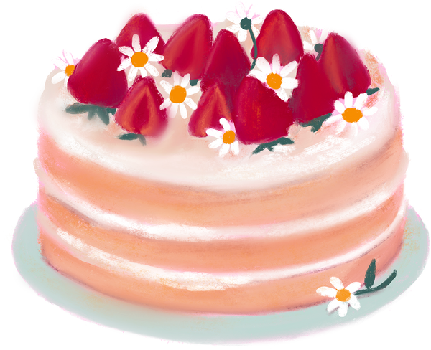

CAKE CLUB AWARDS SHOW
15 January, 2025

Slide 2




LIST OF CONTENTS
State of the “cake” nation
Key insights from the scores
ICC members
Announcement of winner
Cakes
Future Outlook
Key insights from voting

Slide 3







State of the “cake” nation
ICC has succesfully completed the first round of cakes.
We’ve had an impressive 21 cakes.
We’ve had 228 votes scoring all of our cakes.
On average every cake club had ~11 participants
Most was 15 persons, twice
Every job group at IT has participated

Slide 4



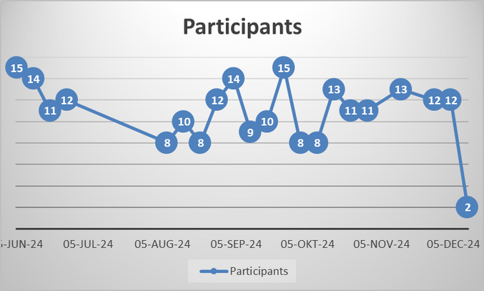




ICC MEMBERS
This quarter, our members consisted of 21 members. Key member highlights include:
Job groups
Gender composition
Cake club participation
Teachers the most represented with 8 members.
15 females and 6 males

Slide 5

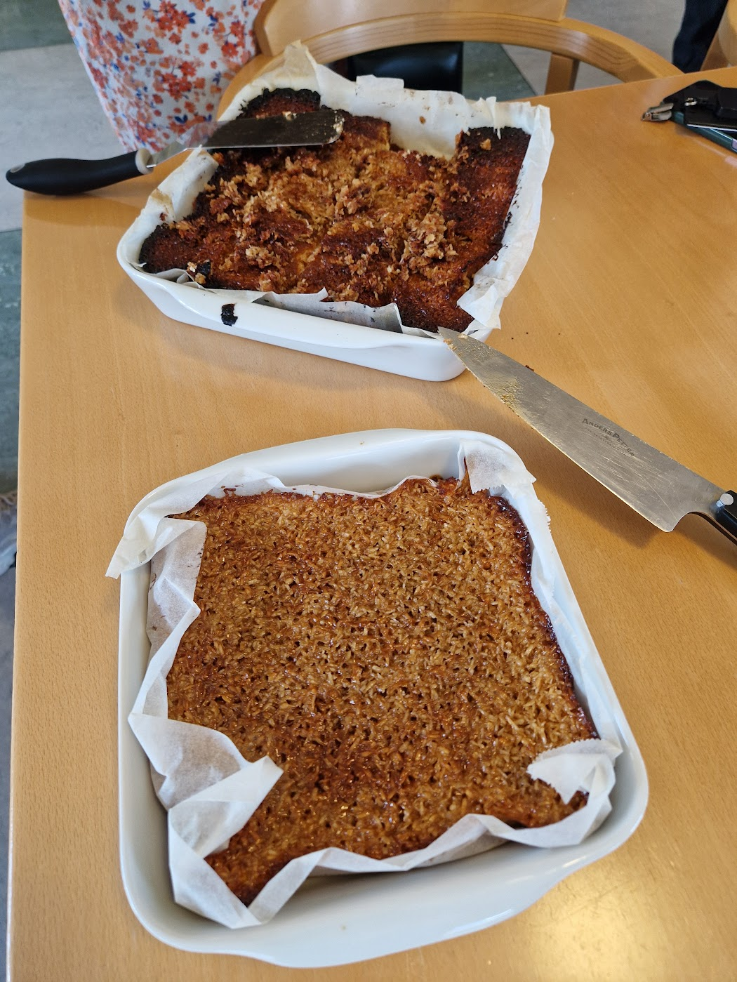
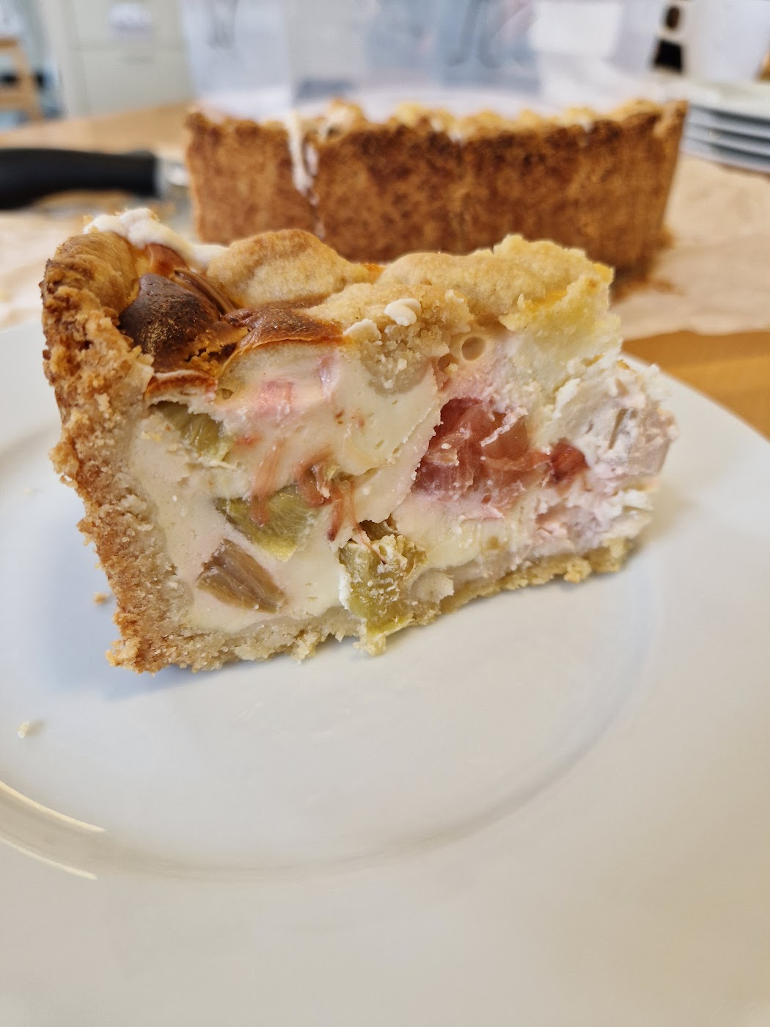
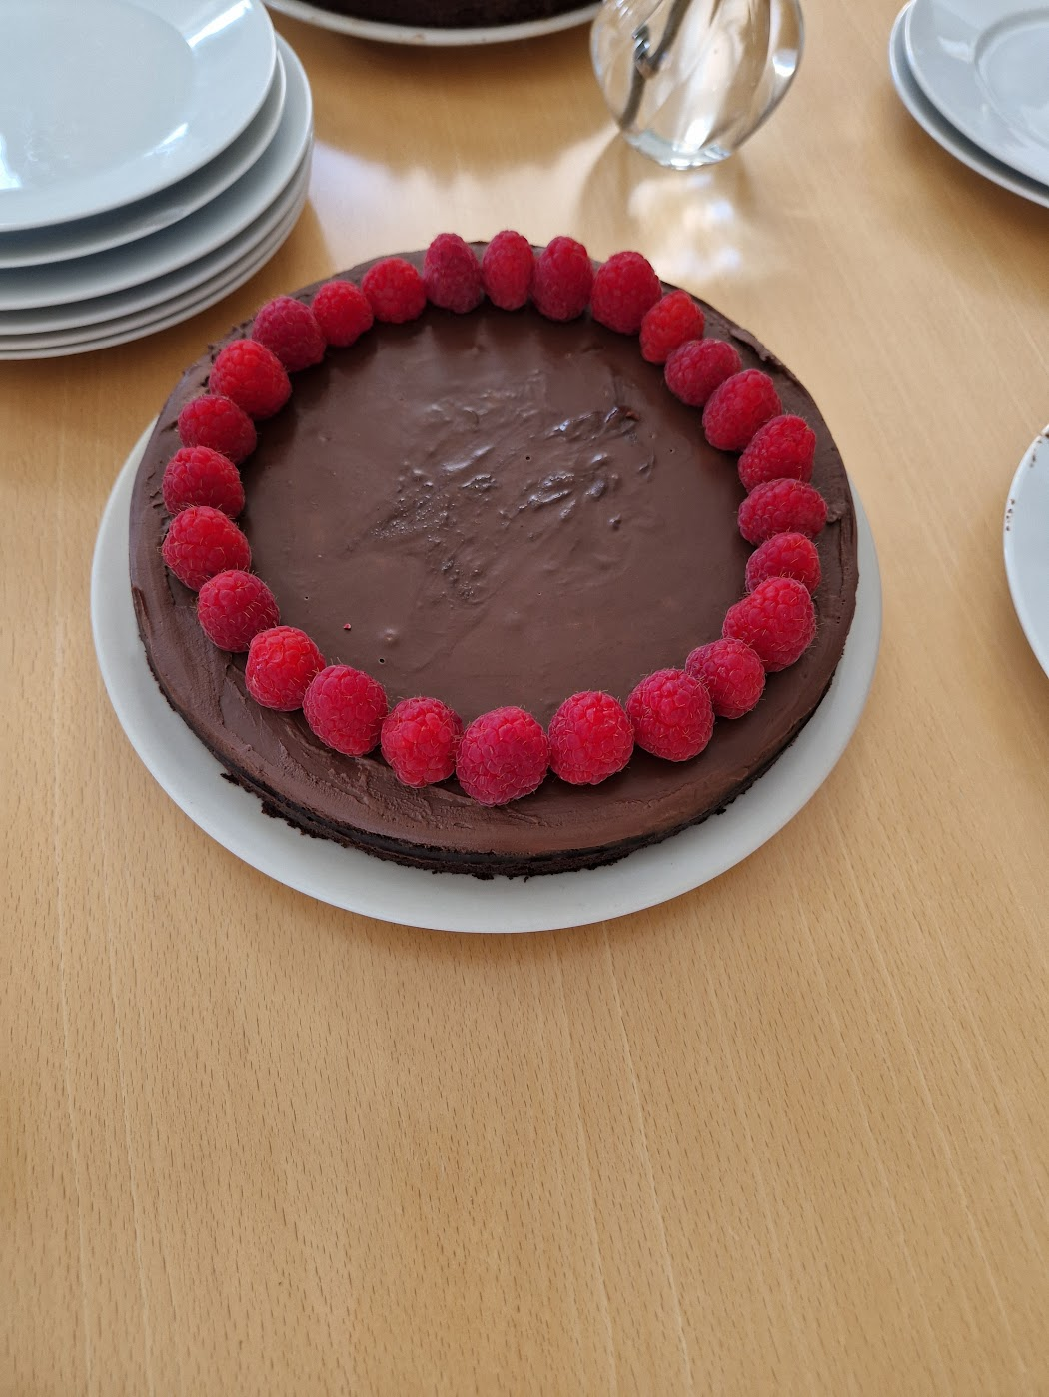
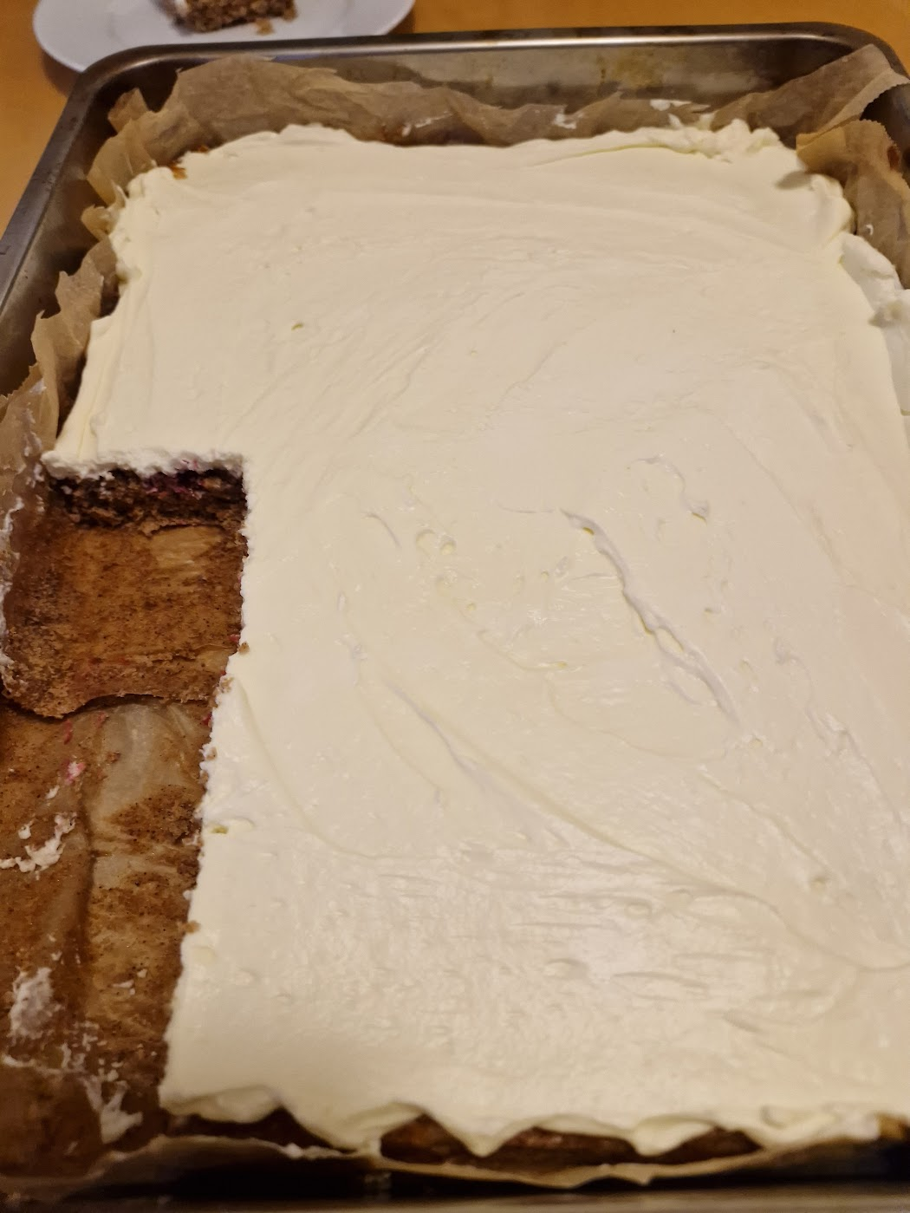
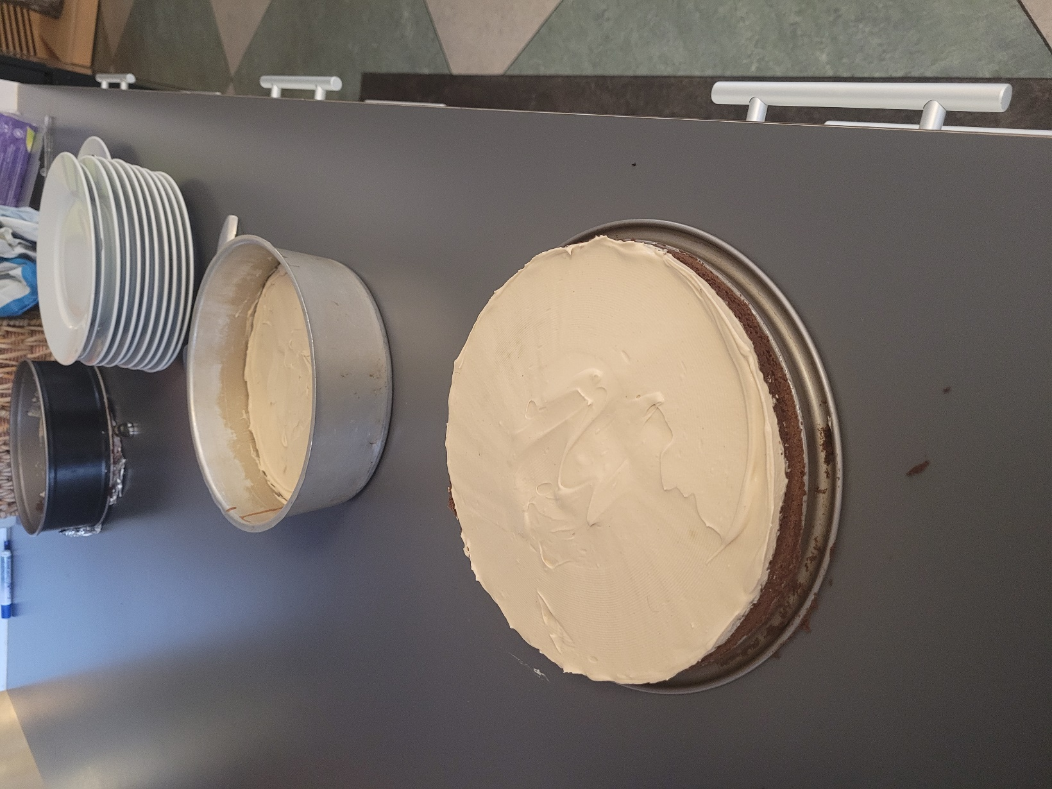
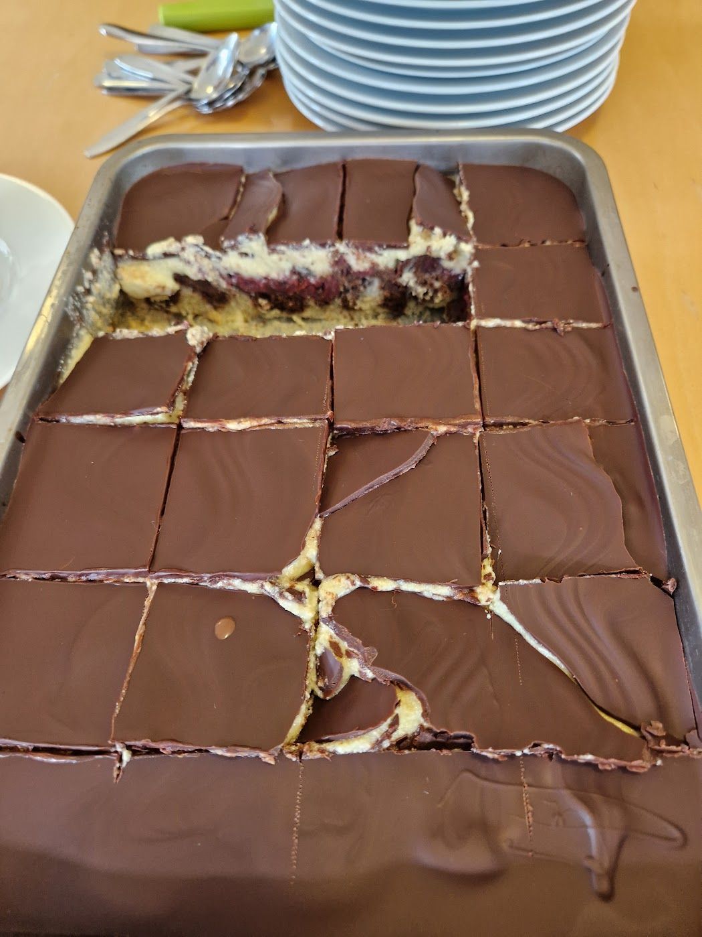
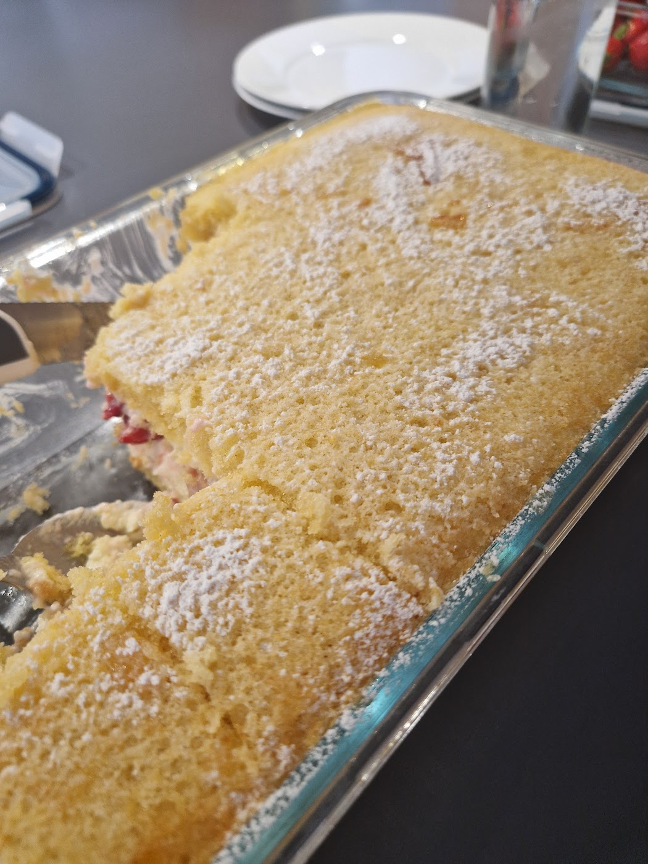
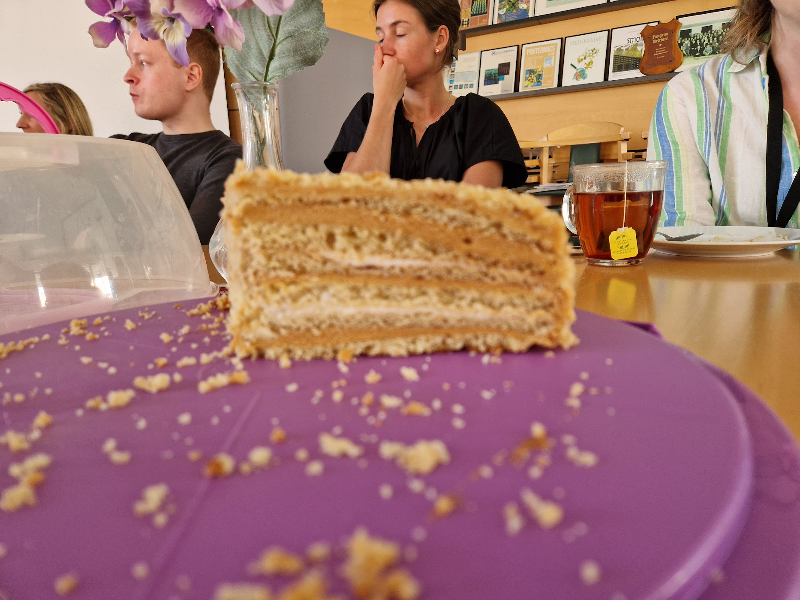
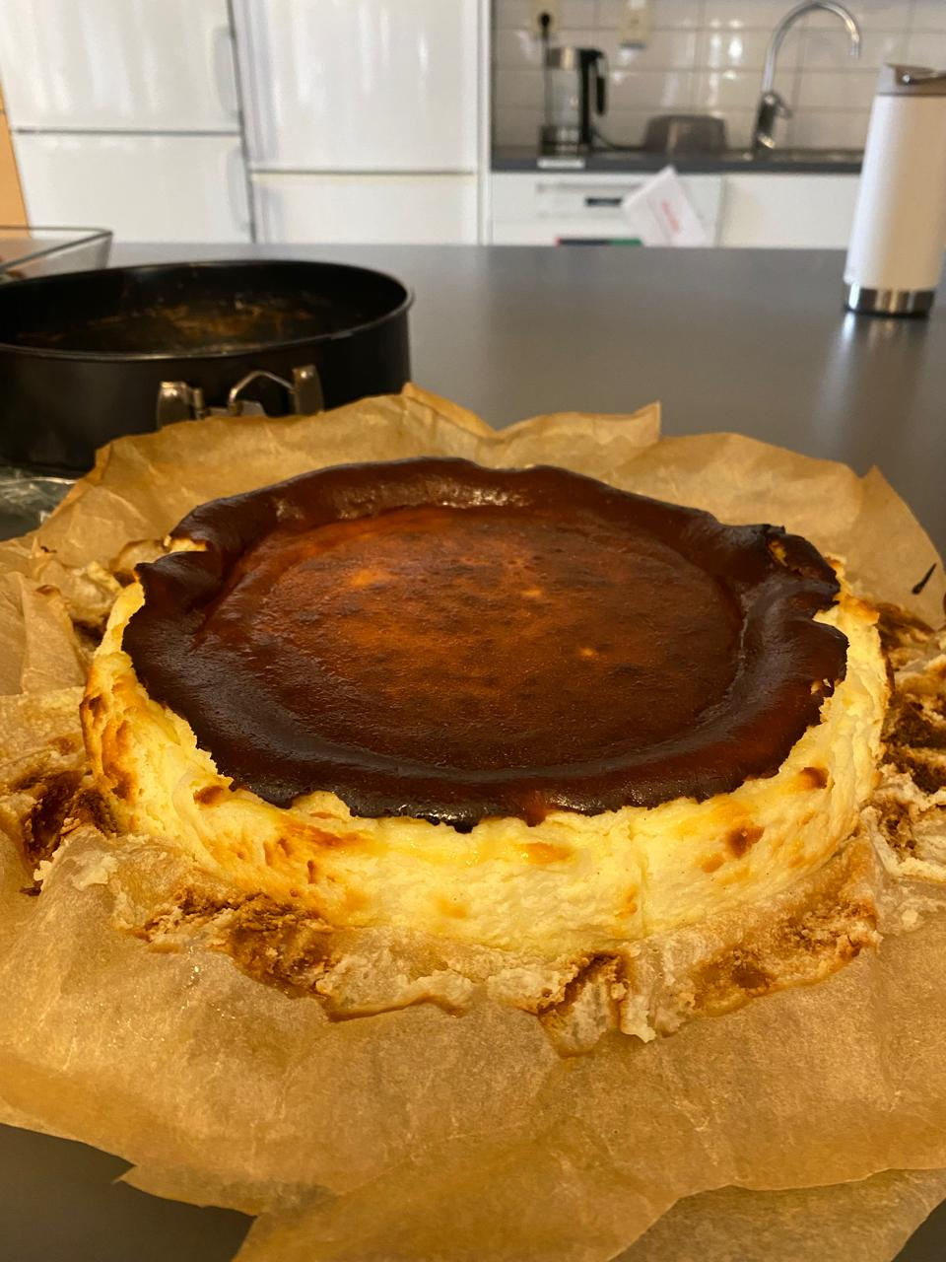
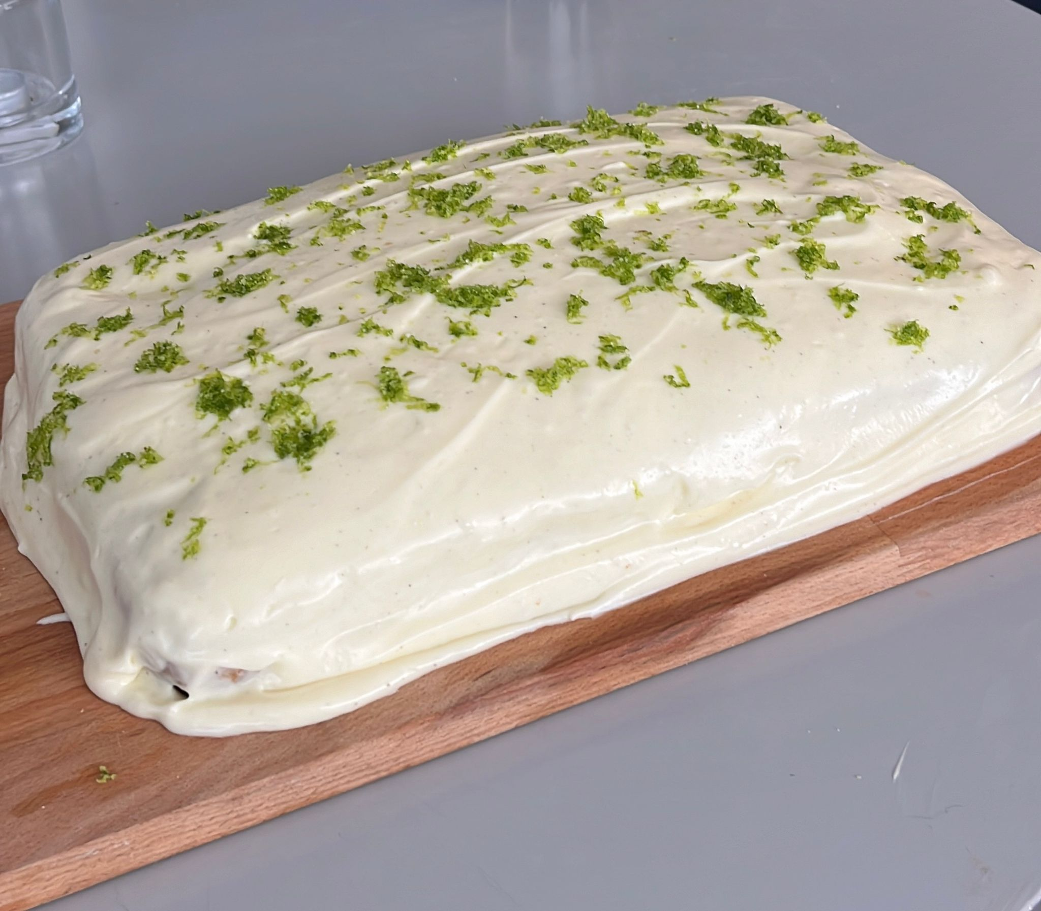
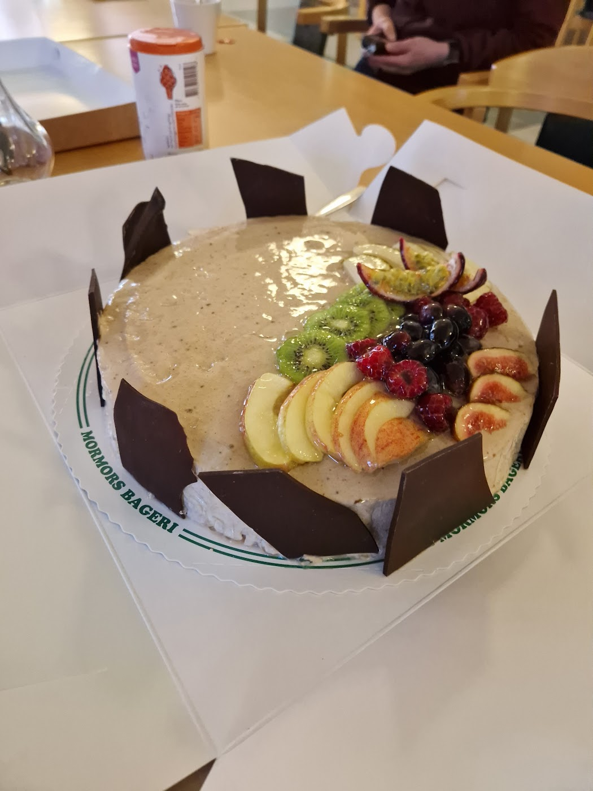
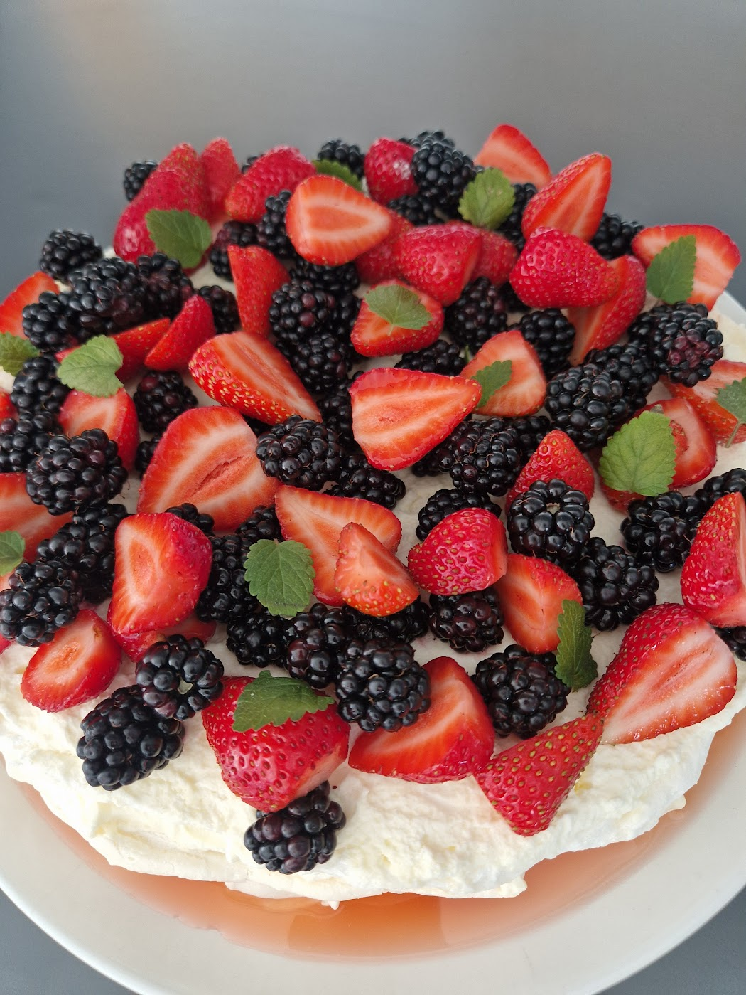
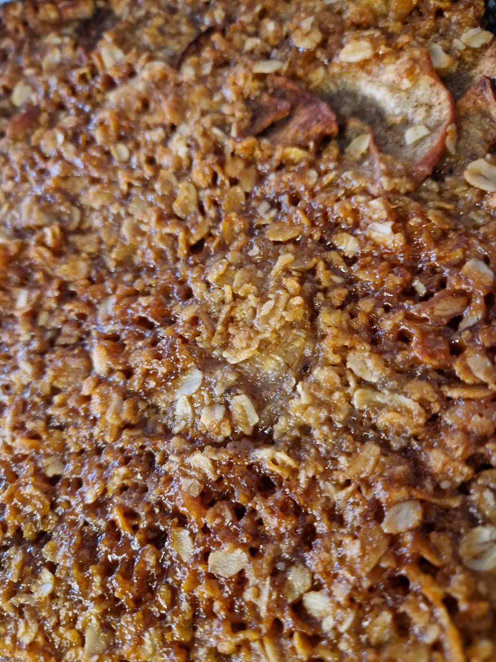
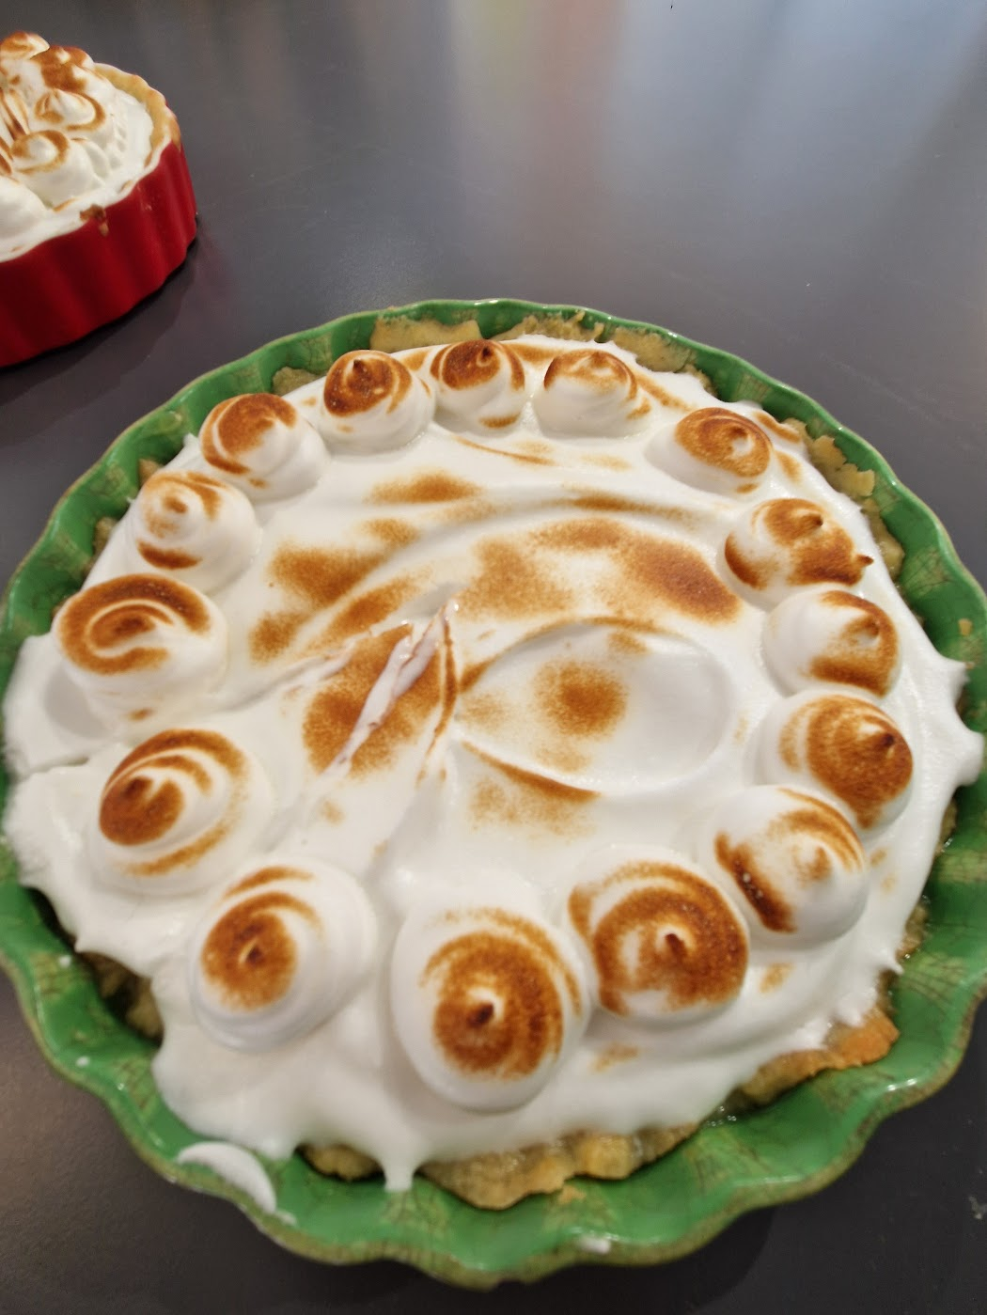
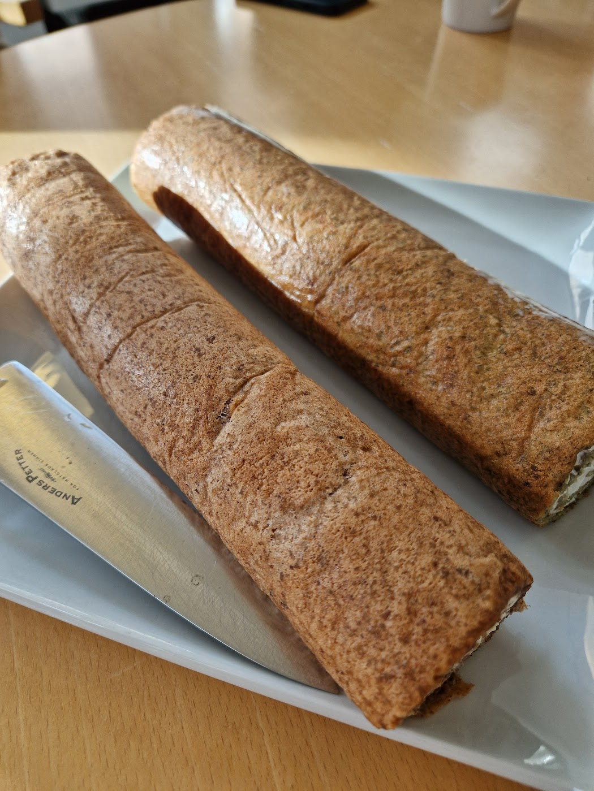
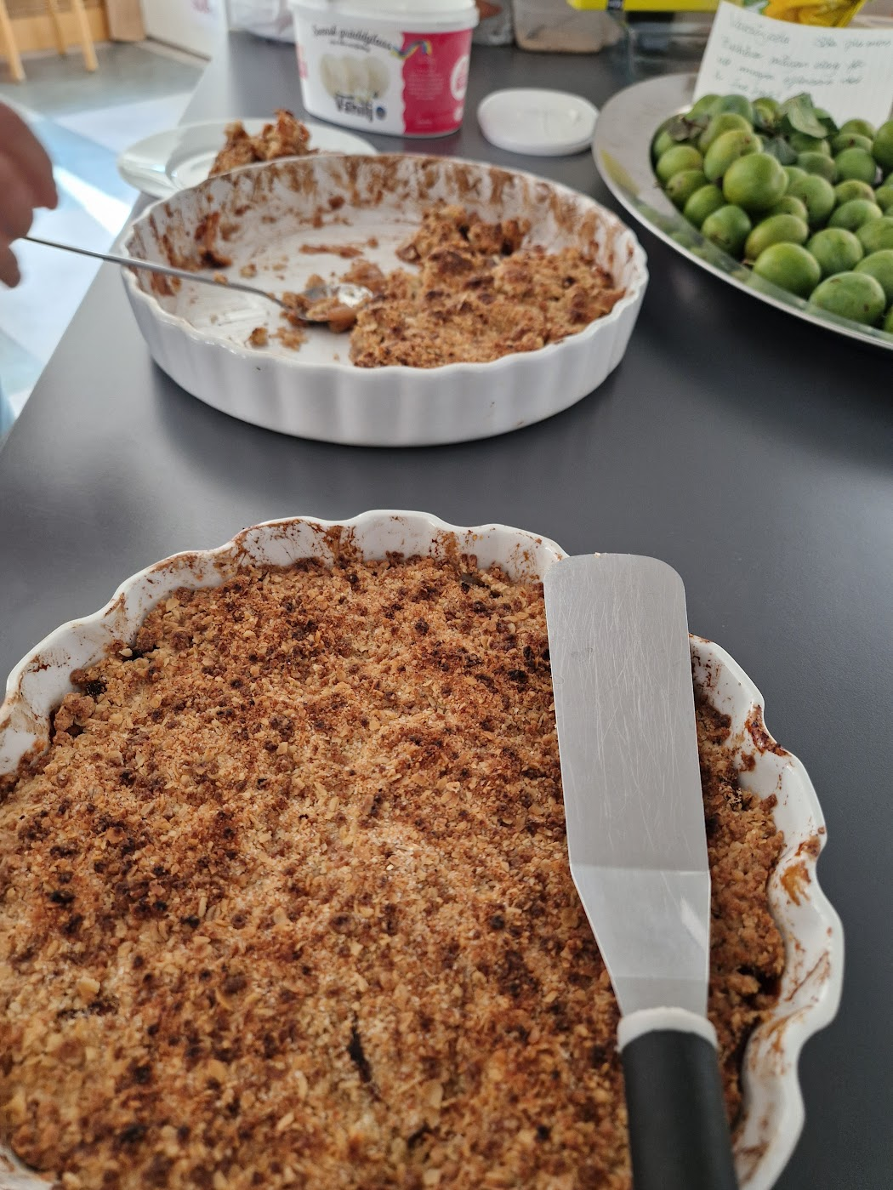
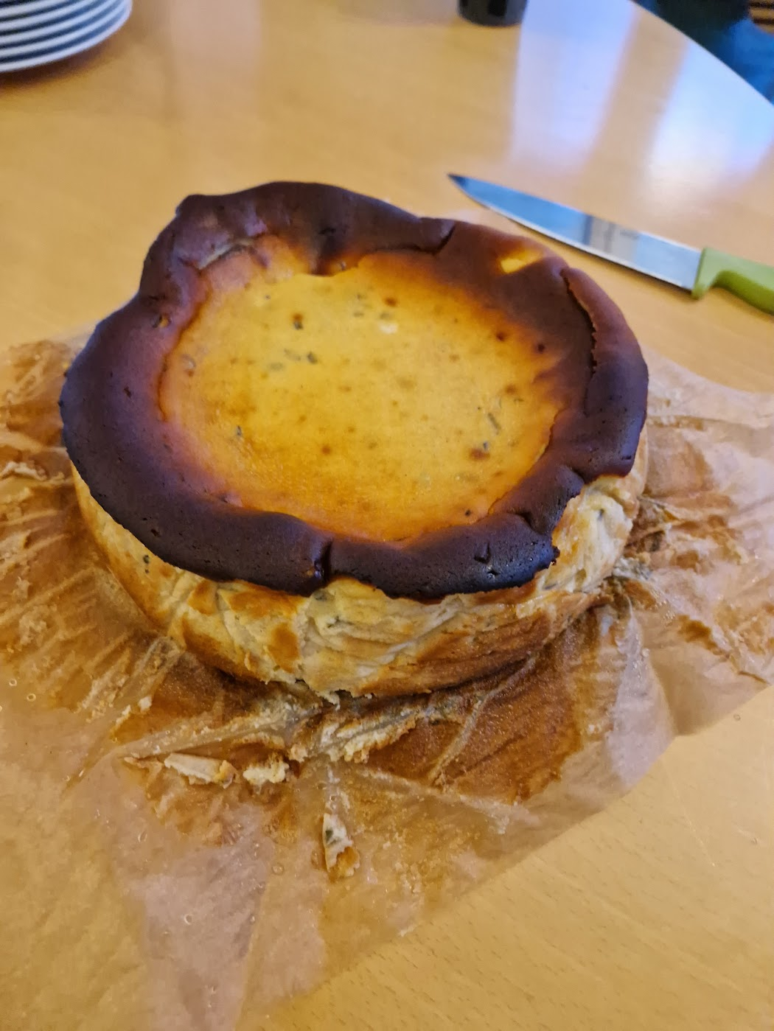

Cakes!
Let’s look at the cakes from this year

Slide 6
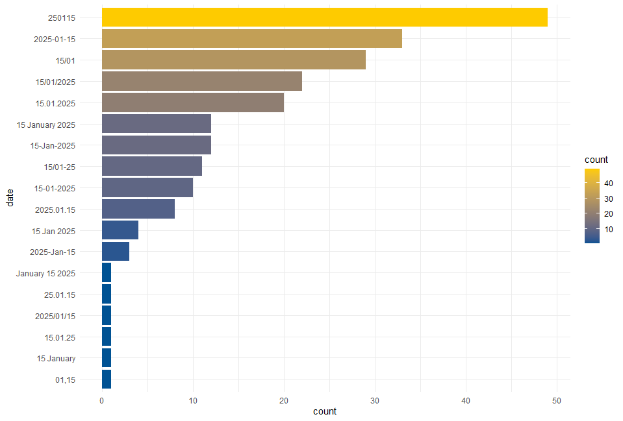
KEY INSIGHTS FROM VOTING
Let’s look at how everyone noted dates

Slide 7
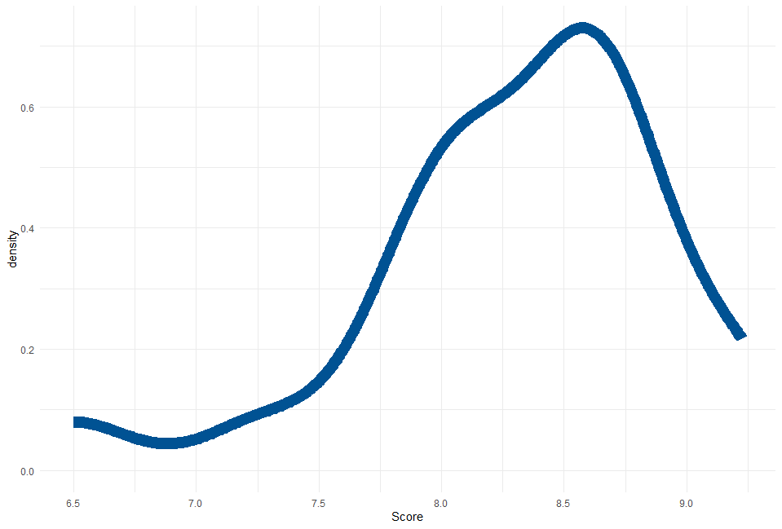
KEY INSIGHTS FROM SCORES
Let’s take a look at how everyone scored the cakes

Slide 8
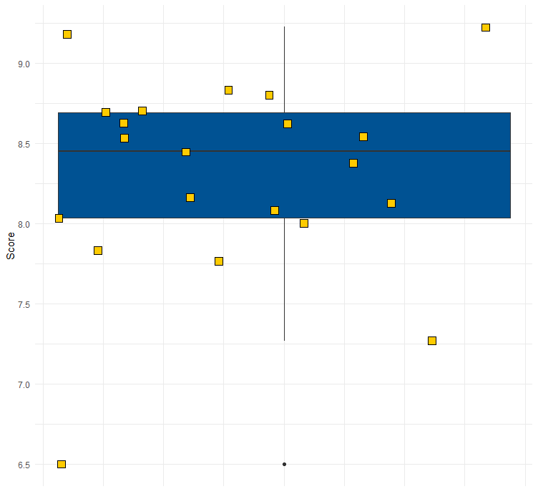
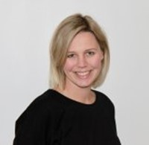
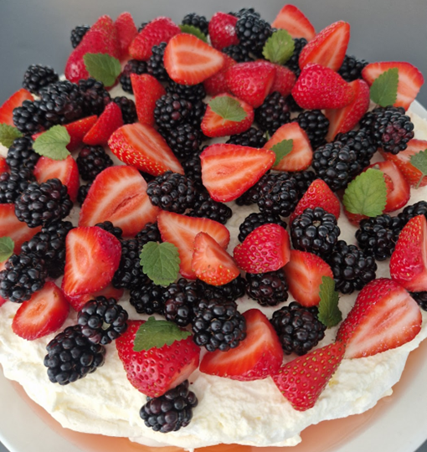
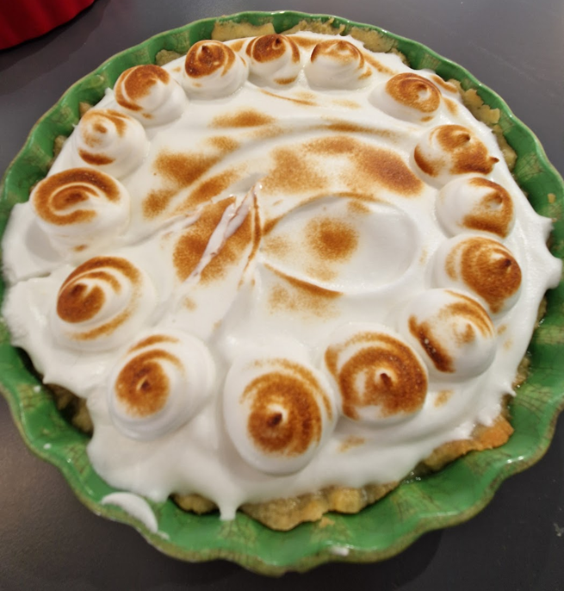
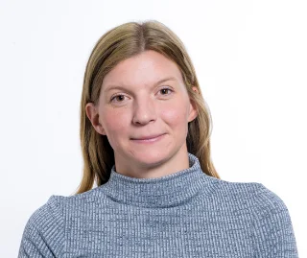
KEY INSIGHTS FROM SCORES
Scores distribution
Average score
8.3
Lemon Merengue Pie
Median score
8.45

Slide 9
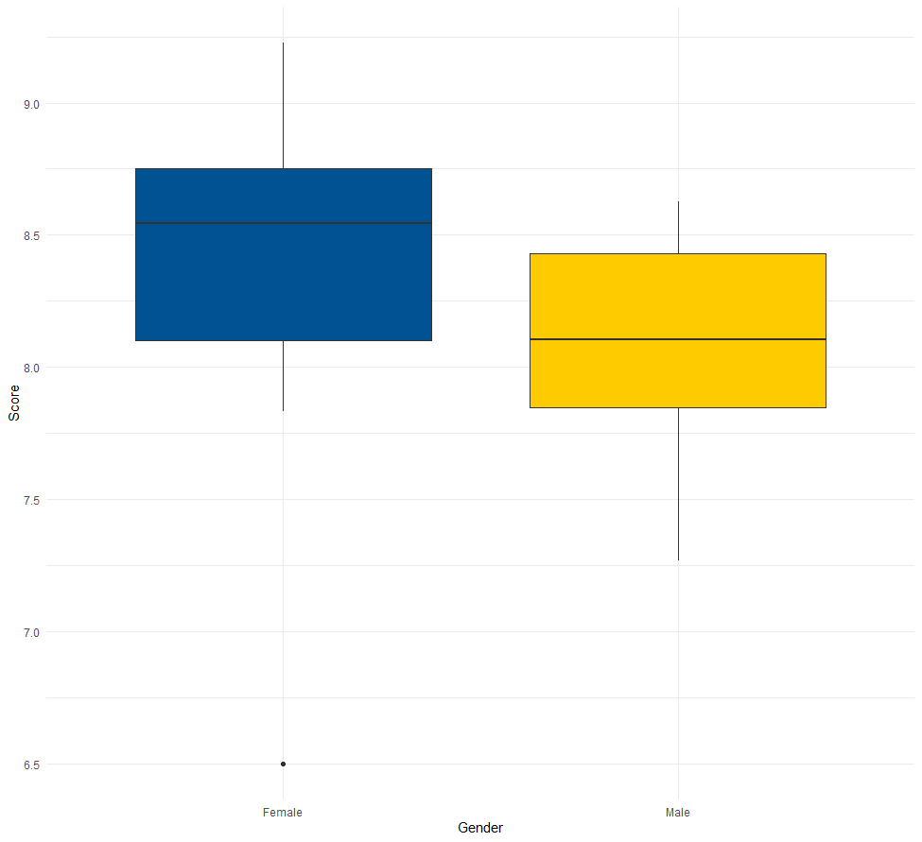
KEY INSIGHTS FROM SCORES
Battle of the sexes!

Slide 10
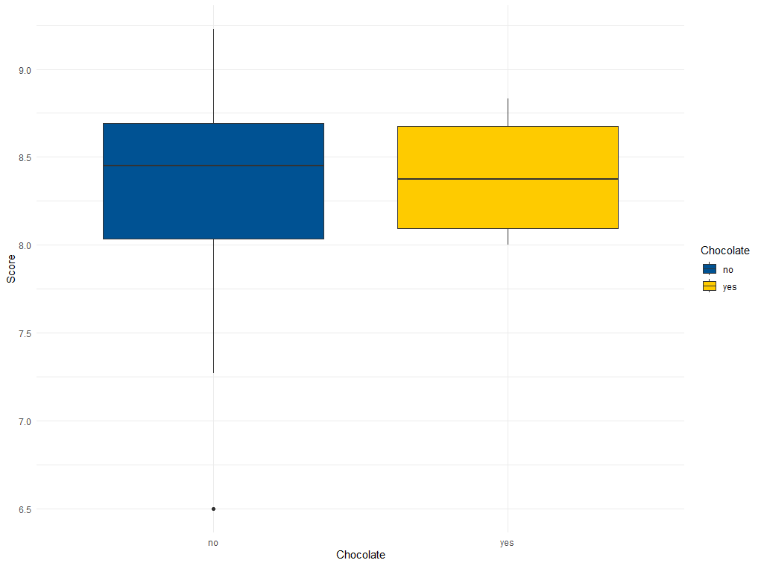
KEY INSIGHTS FROM SCORES
Everyone loves chocolate, or do they?

Slide 11
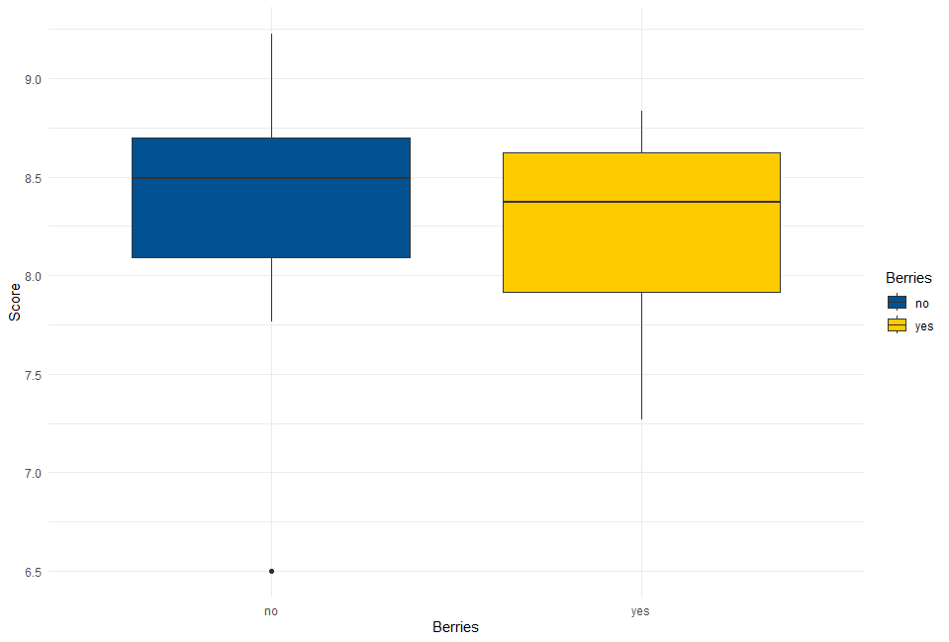
KEY INSIGHTS FROM SCORES
What about the much talked about berries?

Slide 12
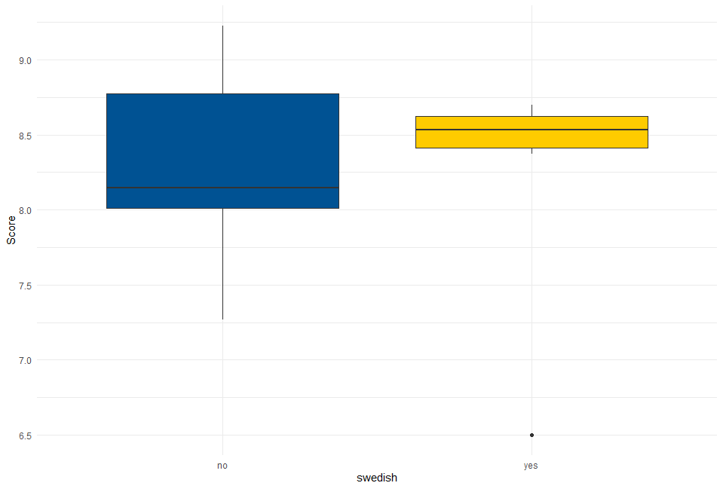

KEY INSIGHTS FROM SCORES
What ensures a good cake?

Slide 13
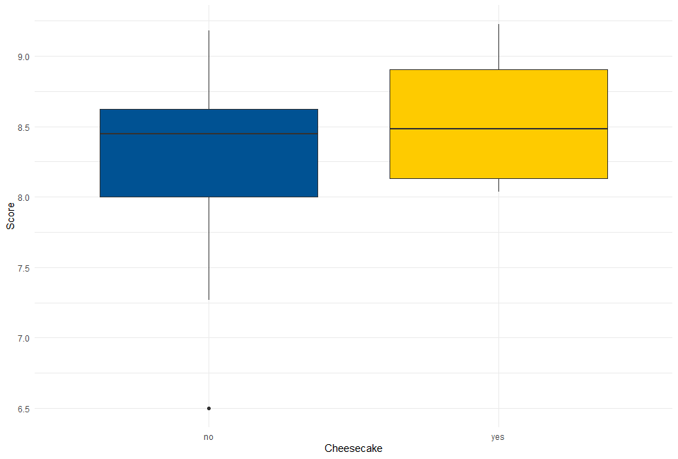
KEY INSIGHTS FROM SCORES
What ensures a good cake?

Slide 14
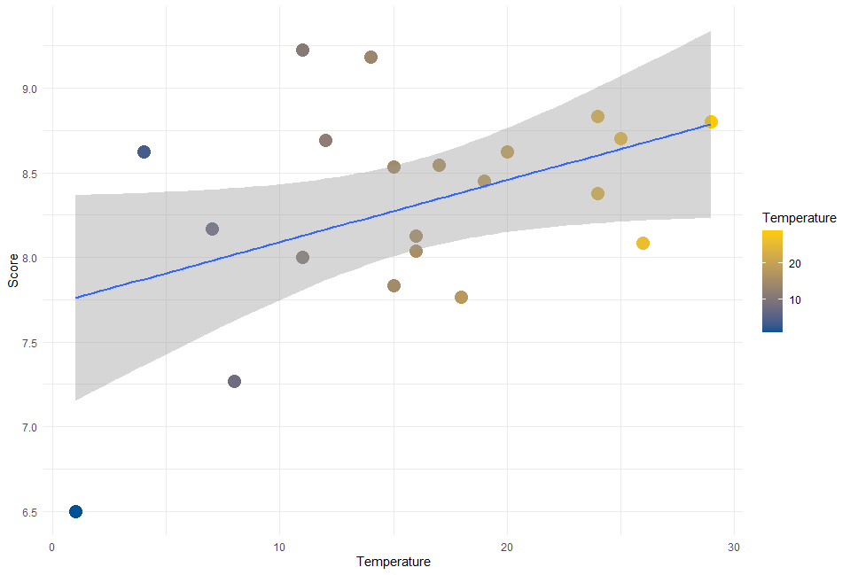
KEY INSIGHTS FROM SCORES
Is cake scores influenced by weather?

Slide 15
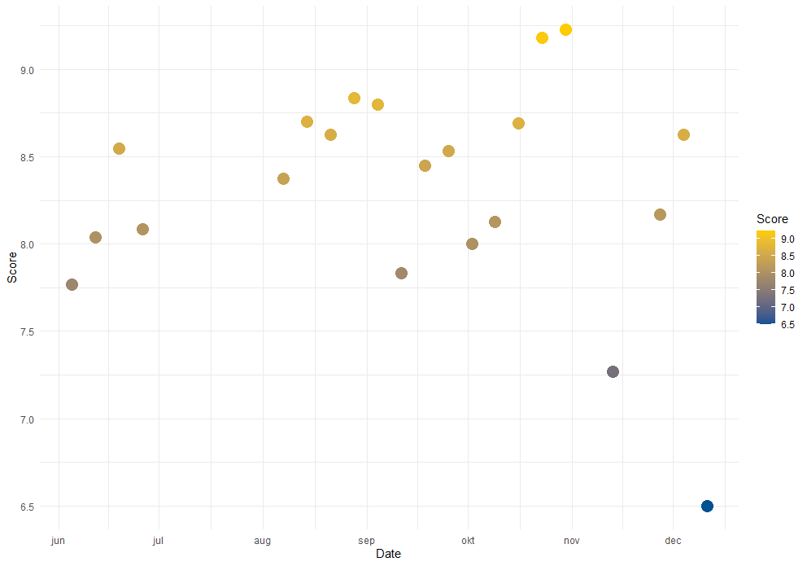
KEY INSIGHTS FROM SCORES
Cake scores over the course of the cake club?

Slide 16
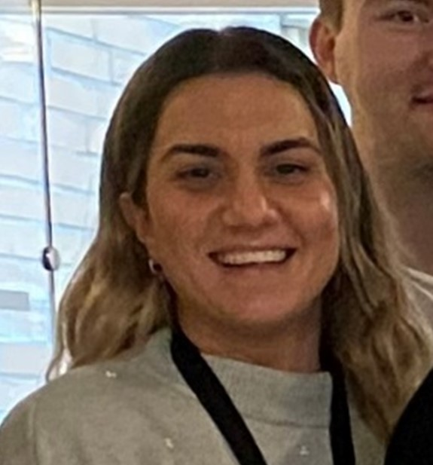
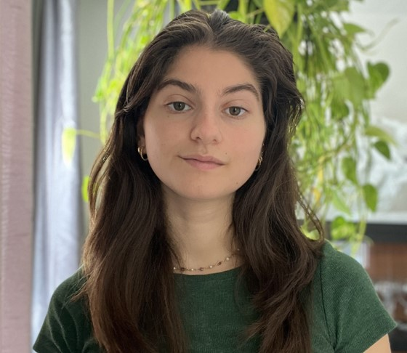
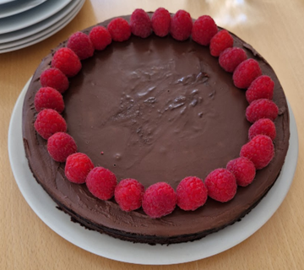
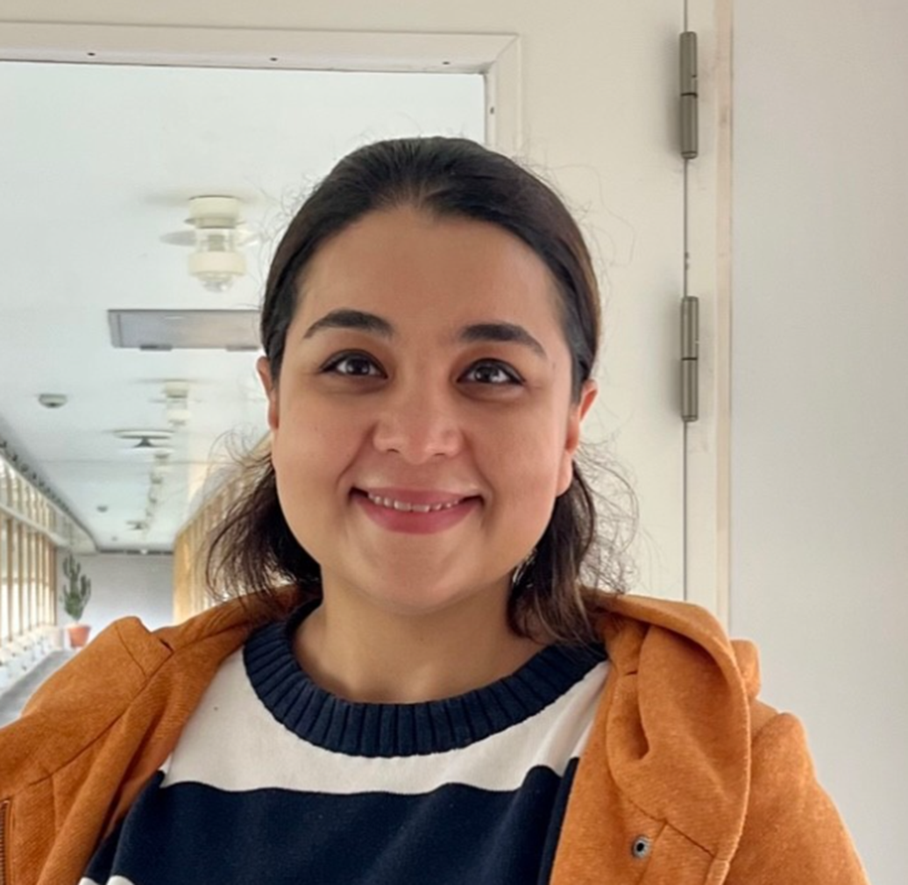
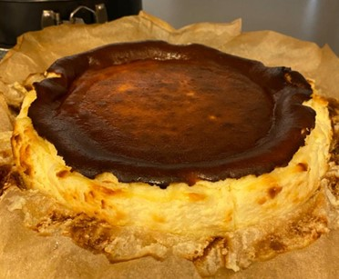
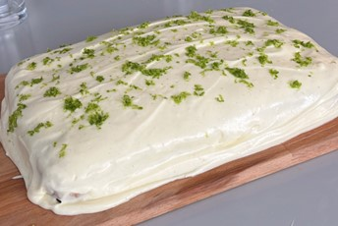
CAKE CLUB TOP 3
Eirini Kalliara
Basque Cheesecake
Score 9.22
Maja Radak
Carrot cake w. lime frosting Score 9.18
Saghar Toresson
Chocolate Dream cake Score 8.83

Slide 17






FUTURE OUTLOOK
Looking ahead, our outlook remains positive. We anticipate:
2nd round of cakes
New participants?
Strategic
Goal
How do we want to set up the second round?
Explore opportunities in people not already a part of the club
Eat nice delicious cake and enjoy a social activity with your colleagues

Slide 18






THANK YOU
We are proud of our achievements this round and excited about our future prospects.

